Slide 1
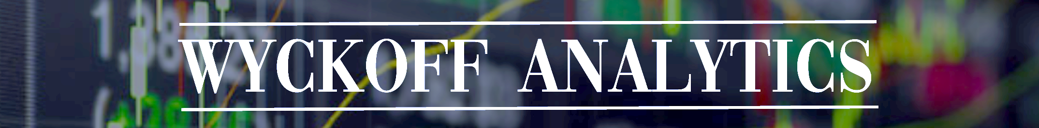
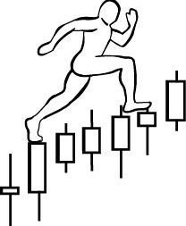
Homework #2:
due on January 21st , 2019
1. Exercise #1: Stock: Home Depot (HD)
Assignment: Label trading ranges with Wyckoff Phases and Events, and CHoCH
2. Watch recording of January 14th session again (optional assignment)
Email your home work to Roman to simplekot@hotmail.com.
Access instructions will be sent out tonight or tomorrow morning.
www.WyckoffAnalytics.com Copyright © 2018 Wyckoff Associates, LLC. All Rights Reserved.

Slide 2
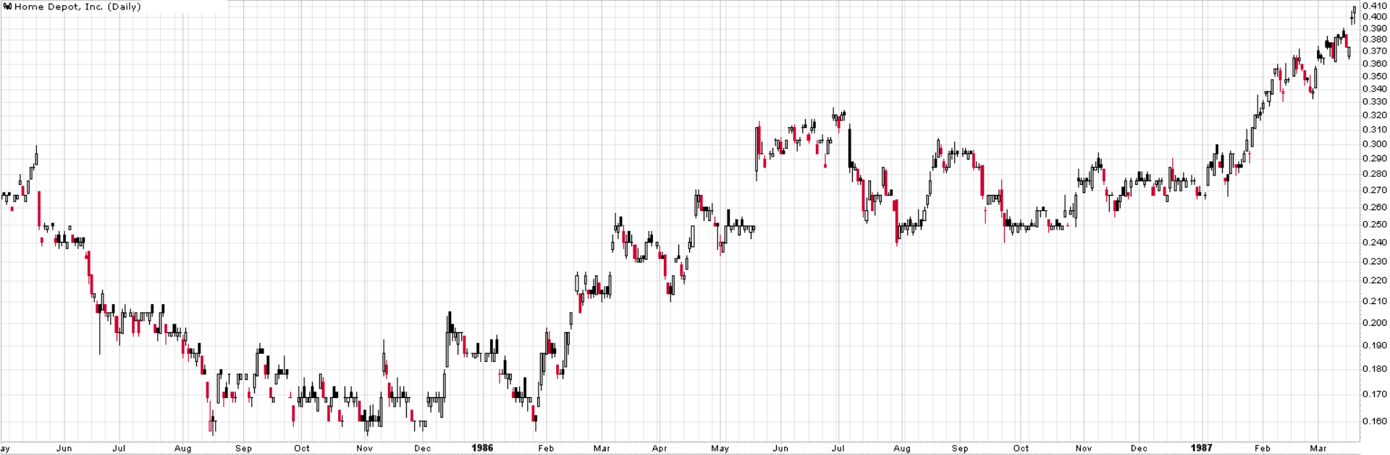
Homework Assignment:
Identify Wyckoff events
Identify Wyckoff phases
Identify Changes of Character
Home assignment #1 – slide 1
HD - Daily
www.WyckoffAnalytics.com Copyright © 2018 Wyckoff Associates, LLC. All Rights Reserved.

Slide 3
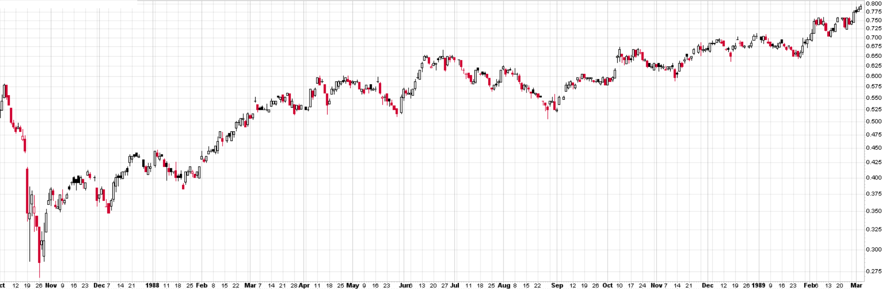
Homework Assignment:
Identify Wyckoff events
Identify Wyckoff phases
Identify Changes of Character
Home assignment #1 – slide 2
HD - Daily
www.WyckoffAnalytics.com Copyright © 2018 Wyckoff Associates, LLC. All Rights Reserved.

Slide 4
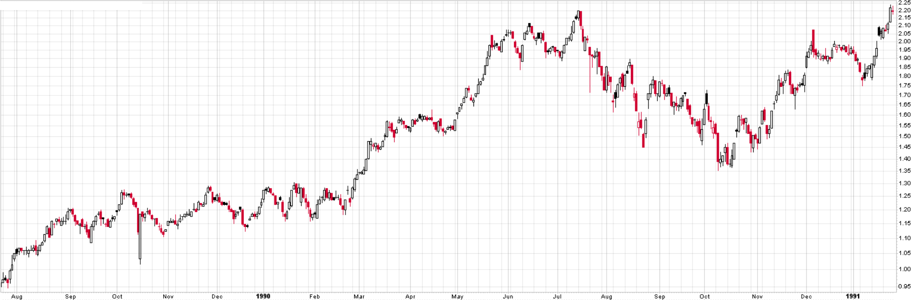
Homework Assignment:
Identify Wyckoff events
Identify Wyckoff phases
Identify Changes of Character
Home assignment #1 – slide 3
HD - Daily
www.WyckoffAnalytics.com Copyright © 2018 Wyckoff Associates, LLC. All Rights Reserved.

Slide 5
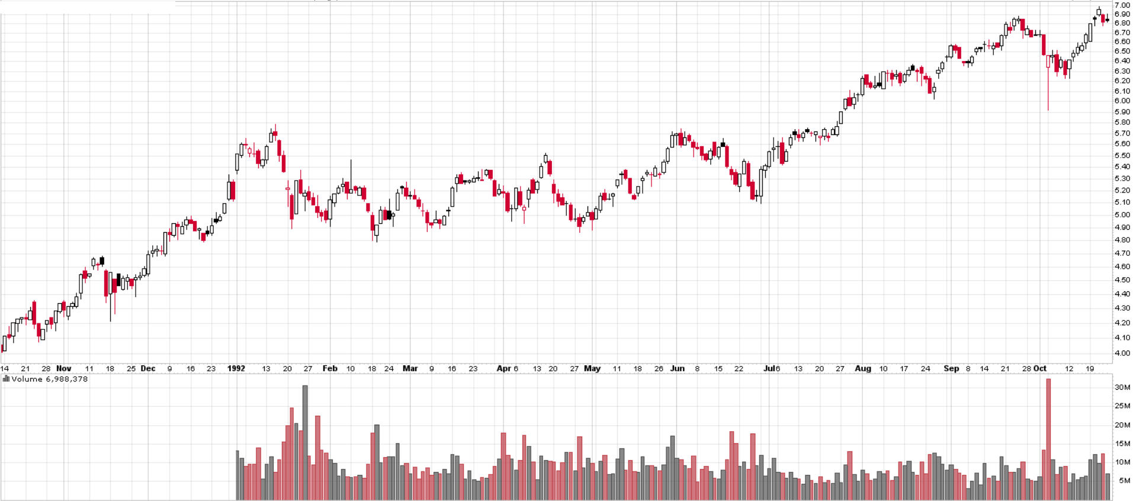
Homework Assignment:
Identify Wyckoff events
Identify Wyckoff phases
Identify Changes of Character
Home assignment #1 – slide 4
HD - Daily
www.WyckoffAnalytics.com Copyright © 2018 Wyckoff Associates, LLC. All Rights Reserved.

Slide 6
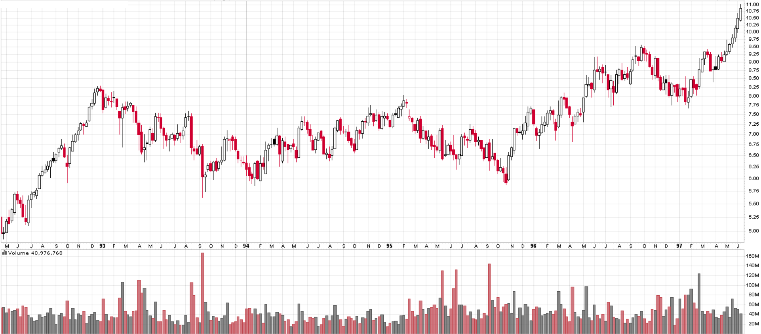
Homework Assignment:
Identify Wyckoff events
Identify Wyckoff phases
Identify Changes of Character
Home assignment #1 – slide 5
HD - Weekly
www.WyckoffAnalytics.com Copyright © 2018 Wyckoff Associates, LLC. All Rights Reserved.

Slide 7
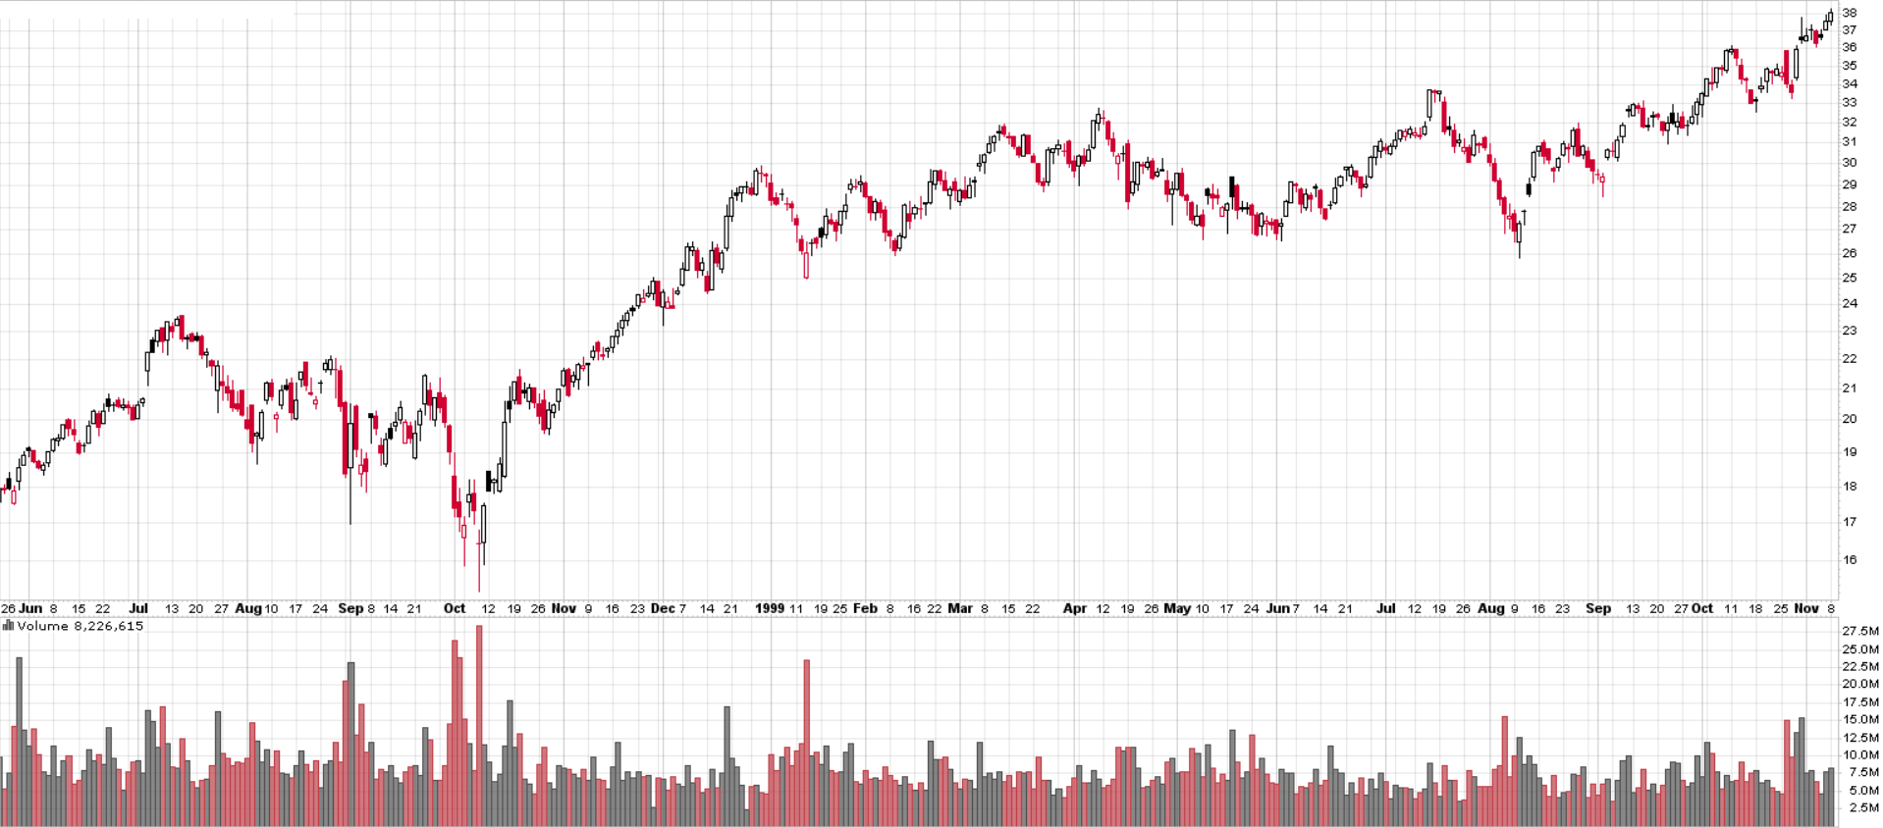
Homework Assignment:
Identify Wyckoff events
Identify Wyckoff phases
Identify Changes of Character
Home assignment #1 – slide 6
HD - Daily
www.WyckoffAnalytics.com Copyright © 2018 Wyckoff Associates, LLC. All Rights Reserved.

